Slide 1
CHAPTER 7
COHERENCE, SYNCHRONIZATION AND MEMORY CONSISTENCY
SYNCHRONIZATION
COHERENCE AND STORE ATOMICITY
SEQUENTIAL CONSISTENCY
MEMORY CONSISTENCY MODELS
SPECULATIVE VIOLATIONS OF MCMs

Slide 2
SHARED-MEMORY COMMUNICATION
IMPLICITELY VIA MEMORY
  PROCESSORS SHARE SOME MEMORY
  COMMUNICATION IS IMPLICIT THROUGH LOADS AND STORES
    NEED TO SYNCHRONIZE
    NEED TO KNOW HOW THE HARDWARE INTERLEAVES ACCESSES FROM DIFFERENT PROCESSORS
NO ASSUMPTION ON THE RELATIVE SPEED OF PROCESSORS

Slide 3
SYNCHRONIZATION
Need for “Mutual Exclusion”
Assume the following statements are executed by 2 threads, T1 and T2, on A
T1 T2
A<- A+1 A<- A+1
The programmer’s expectation is that, whatever the order of execution of the two statements is, the final result will be that A is incremented by 2
However program statements are not executed in an atomic fashion.
Compiled code on a RISC machine will include several instructions
A possible interleaving is:
T1 T2
r1 <- A
r1 <- A
r1 <- r1 + 1
r1 <- r1 + 1
A <- r1
A <- r1
At the end the result is that A has been incremented by 1 (NOT 2)

Slide 4
MUTUAL EXCLUSION
We must have a way to make program statements appear atomic
Critical sections
  provided by lock and unlock primitives framing the statement(s)
  modifications are “released” atomically at the end of the critical section
So the code should be:
T1 T2
lock(La) lock(La) /acquire
A<- A+1 A<- A+1
unlock(La) unlock(La) /release
        HONOR SYSTEM
DEKKER’S ALGORITHMS FOR LOCKING
ASSUME A AND B ARE BOTH 0 INITIALLY
T1 T2
A:=1 B:=1 /acquire
while(B==1); while(A==1);
<critical section> <critical section>
A:=0 B:=0 /release
At most one process can be in the critical section at any one time.
Deadlock
Complex (to solve deadlock and synchronize more than 2 threads)
USE HARDWARE PRIMITIVES TO SYNCHRONIZE

Slide 5
BARRIER SYNCHRONIZATION
Global synchronization among all threads
ALL threads must reach the barrier before ANY thread is allowed to execute beyond the barrier
P1 P2
... ...
BAR := BAR+1; BAR := BAR +1;
while (BAR < 2); while (BAR < 2);
Note: need a critical section to increment BAR
  no need of a critical section to read BAR in the while statement
In practice, more complex because barrier count must be reset for the next iteration
Barriers can effectively implement critical sections
POINT-TO-POINT SYNCHRONIZATION
T1 T2
A = 1;
FLAG = 1; /release
while (FLAG==0); /acquire
print A
Note: no need for critical sections to update and read FLAG
Signal sent by T1 to T2 through FLAG (Producer/Consumer synchronization)

Slide 6
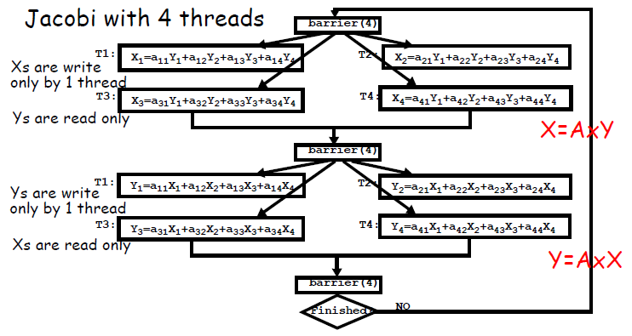
EXAMPLE
In 1st phase accesses to Xi’s are mutually exclusive
In 2nd phase, multiple accesses to Xi’s (read-only)
Opposite is true for Yi’s

Slide 7
SYNCHRONIZATION
ACQUIRE METHOD
  ACQUIRE ACCESSES RIGHT TO THE SYNCHRONIZATION (ENTER CRITICAL SECTION, GO PAST EVENT)
RELEASE METHOD
  ENABLE OTHER PROCESSORS TO ACQUIRE THE RIGHT TO THE SYNCHRONIZATION
WAITING ALGORITHM
  BLOCKING
    WAITING PROCESSES ARE DESCHEDULED
    HIGH OVERHEAD
    ALLOWS PROCESSOR TO WORK ON SOMETHING ELSE
  BUSY WAITING
    WAITING PROCESSES REPEATEDLY TEST A LOCATION UNTIL IT CHANGES VALUE
    RELEASING PROCESS SETS THE LOCATION
    LOW OVERHEAD BUT HOLDS THE PROCESSOR
    MAY HAVE HIGH MEMORY/NETWORK TRAFFIC
  IN HARWARE MULTITHREADED CORES, CONSIDER IT A LONG LATENCY EVENT AND SWITCH TO OTHER
BUSY-WAITING IS BETTER WHEN
  SCHEDULING OVERHEAD IS LARGER THAN EXPECTED WAIT TIME
  NO OTHER TASK TO RUN
  OS KERNEL

Slide 8
LOCKS
HARDWARE LOCKS
  SEPARATE LOCK LINES ON THE BUS: HOLDER OF A LOCK ASSERT THE LINE
  LOCK REGISTERS
    SET OF SHARED REGISTERS
  INFLEXIBLE
    NOT GOOD FOR GENERAL PURPOSE USE
    HARDWIRED WAITING ALGORITHM
ISA SUPPORT: MOST MODERN MACHINES USE A FORM OF ATOMIC READ-MODIFY-WRITE
  IBM 370: ATOMIC COMPARE AND SWAP
  X86: ANY INSTRUCTION CAN BE PREFIXED WITH A LOCK
  SPARC: SWAP
  MIPS, PowerPC: SUPPORT FROM PAIRS OF INSTRUCTIONS
    LOAD-LOCKED, STORE-CONDITIONAL
THESE BASIC MECHANISMS ARE USED TO BUILD SOFTWARE LOCKS

Slide 9
SIMPLE SOFTWARE LOCKS
Lock: LW R2, lock
BNEZ R2, Lock
SW R1, lock /R1 = 1
RET
Unlock: SW R0, lock
RET
PROBLEM: LOCK IS NOT ATOMIC--TWO THREADS CAN GAIN THE LOCK AT THE SAME TIME
SOLUTION: ATOMIC READ/WRITE OR SWAP INSTRUCTION
  ATOMICALLY READ THE VALUE OF THE LOCATION AND SET IT TO ANOTHER VALUE
  RETURN SUCCESS OR FAILURE
SIMPLEST ONE: TEST_AND_SET (T&S)
  T&S R1, lock
    READ LOCK IN R1
    WRITE 1 IN LOCK
    SUCCESS IF VALUE READ IN R1 IS 0
    FAILURE IF IT IS 1
MUST BE ATOMIC

Slide 10
SOFTWARE LOCKS
Lock: T&S R1, lock
BNEZ R1, Lock
RET
Unlock: SW R0, lock
RET
OTHER R/M/W ATOMIC OPERATIONS
  SWAP R1, MEM_LOC: EXCHANGE THE CONTENT OF R1 AND MEM_LOC
  FETCH&OP
    EXAMPLE: F&A (R1, MEM_LOC, CONST), WHERE CONST IS A SMALL VALUE.
    FETCH MEM_LOC IN R1, THEN ADD CONST TO MEM_LOC.
  COMPARE&SWAP
    CAS (R1, R2, MEM_LOC)
    COMPARE MEM_LOC TO R1 AND IF THEY ARE EQUAL SWAP R2 AND MEM_LOC

Slide 11
REDUCE FREQUENCY OF ISSUING T&S
T&S WITH BACKOFF
  INCREASE THE DELAY UNTIL THE NEXT TRIAL AFTER EVERY FAILURE
  E.G., EXPONENTIAL BACKOFF
  BACKOFF BY k X c^{i} AT THE ith TRIAL
TEST AND TEST&SET LOCK
  TEST WITH ORDINARY LOADS
  WHEN VALUE CHANGES TO 0, TRY TO OBTAIN LOCK WITH T&S
  WORKS WELL WITH CACHE
Lock: LW R1,lock
BNEZ R1,Lock
T&S R1,lock
BNEZ R1,Lock
RET
Unlock: SW R0,lock
RET

Slide 12
LOAD-LOCKED AND STORE CONDITIONAL
T&S(Rx,lock): ADDI R1,R0,1
LL Rx,lock
SC R1,lock
BEQZ R1, T&S
RET
LOAD-LOCKED or LOAD-LINKED (LL)
  LL READS lock IN REGISTER Rx
STORE CONDITIONAL (SC)
  TRIES TO STORE 1 IN lock:
  SUCCEEDS IF NO OTHER THREAD HAS WRITTEN INTO lock SINCE LL
  IF SC SUCCEEDS THE SEQUENCE LL-SC WAS ATOMIC
  IF SC FAILS, IT DOES NOT WRITE TO MEMORY; RATHER IT SETS R1 TO 0
SC CAN FAIL IF
  IT DETECTS INTERVENING WRITES TO lock SINCE LL
  IT TRIES TO GET THE BUS, BUT ANOTHER SC SUCCEEDS FIRST
TWO ADVANTAGES:
  EASIER TO IMPLEMENT IN A PIPELINE
  FLEXIBILITY

Slide 13
LOAD-LOCKED AND STORE CONDITIONAL
FANCIER ATOMIC OPS CAN BE IMPLEMENTED BY ADDING CODE BETWEEN LL AND SC
  KEEP IT SIMPLE SO THAT SC IS LIKELY TO SUCCEED
  AVOID INSTRUCTIONS THAT CANNOT BE UNDONE (eg, STORE, INSTRUCTIONS CAUSING EXCEPTIONS)
EXAMPLE: CAS
CAS(Rx,Ry,X) ADD R2,Ry,R0 /save Ry
LL R1,X
BNE Rx,R1,return
SC R2,X /attempt to store Ry
BEQZ R2,CAS
ADD Ry,R1,R0 /return X in Ry
RET
IMPLEMENTATION
  LL-BIT IS SET WHEN LL IS EXECUTED
  BUS INTERFACE SNOOPS UPDATE OR INVALIDATE SIGNALS AND RESETS LL-BIT
  SC TESTS LL-BIT, AND FAILS IF RESET
  COULD HAVE MULTIPLE LL-BITS FOR DIFFERENT ADDRESSES.

Slide 14
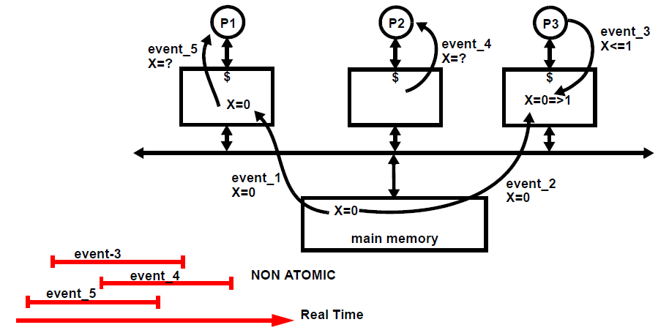
MEMORY COHERENCE: WHAT’S THE PROBLEM
CAUSED BY MULTIPLE COPIES OF THE SAME DATA
ASSUME THAT EVENTS 1,2,3,4, AND 5
  DO NOT OVERLAP IN TIME, OR
  ARE ATOMIC (TAKE ZERO TIME)
PROCESSORS P1 AND P2 “SEE” DIFFERENT VALUES OF X AFTER EVENT 3
SEEMS SIMPLE TO SOLVE: SIMPLY INFORM COPIES ON EVERY UPDATE

Slide 15
COHERENCE: WHY IT IS SO HARD
AFTER EVENT 3, THE CACHES CONTAIN DIFFERENT COPIES. IS THIS STILL COHERENT?
  THE ANSWER IS “YES”, FOR AS LONG AS P1 OR P2 DO NOT EXECUTE THEIR LOADs
  A SYSTEM SHOULD REMAIN COHERENT FOR AS LONG AS INCOHERENCE IS NOT DETECTED. OTHERWISE SAME RESULT.
CAN THE LOADs IN EVENTS 4 AND 5 RETURN 0 OR 1?COHERENT?
  YES, EITHER WOULD STILL BE COHERENT
  BECAUSE SOFTWARE CANNOT DETECT THE DIFFERENCE
  P1 OR P2 COULD HAVE RUN SLIGHTLY FASTER, SO THAT EVENTS 4 AND 5 OCCUR BEFORE EVENT 3 IN TIME.
IN PRACTICE, MUCH MORE COMPLEX BECAUSE MEMORY EVENTS ARE NOT ATOMIC AND DO SOMETIMES OVERLAP IN TIME
  FOR EXAMPLE, EVENTS 3, 4, AND 5 MAY BE TRIGGERED IN THE SAME CLOCK
  THEY CONFLICT IN SOME PARTS OF THE HARDWARE WHERE THEY ARE SERIALIZED
  HOWEVER, THEY CAN PROCEED INDEPENDENTLY IN PARALLEL (TEMPORAL OVERLAP) ON THEIR OWN HARDWARE PATHS
LET’S ASSUME FIRST THAT COHERENCE TRANSITIONS ARE ATOMIC OR DO NOT OVERLAP IN TIME
  HELPS UNDERSTAND HOW TO PROPAGATE VALUES EFFECTIVELY
  PROTOCOL DESCRIPTION AT THE “BEHAVIORIAL” LEVEL (HOW IT’S SUPPOSED TO BEHAVE; NO IMPLEMENTATION DETAILS)
  SEE CHAPTER 5 FOR PROTOCOL DESCRIPTIONS

Slide 16
WRITE-BACK: MSI INVALIDATE PROTOCOL
BLOCK STATES:
  Invalid (I);
  Shared (S): one copy or more, memory is clean;
  Dirty (D) or Modified (M): one copy, memory is stale
PROCESSOR REQUESTS
  PrRd or PrWr
BUS TRANSACTIONS
  BusRd: requests copy with no intent to modify
  BusRdX: requests copy with intent to modify
  WRITE TO SHARED BLOCK: COULD USE BusUpgr INSTEAD OF BusRdX
  FLUSH: FORWARD BLOCK COPY TO REQUESTER (MEMORY COPY IS STALE)
    MEMORY SHOULD BE UPDATED AT THE SAME TIME

Slide 17
WRITE-BACK: MSI UPDATE PROTOCOL
BLOCK STATES:
  Invalid (I);
  Shared (S): multiple copies, memory is clean;
  Dirty (D) or Modified (M): one copy, memory is stale
PROCESSOR REQUESTS
  PrRd or Pr Wr
BUS TRANSACTIONS
  BusRd: requests copy
  BusUpdate: update remote copies
SHARED BUS LINE (S): INDICATES WHETHER REMOTE COPIES EXIST

Slide 18
STRICT COHERENCE
STRICT COHERENCE
  “A memory system is coherent if the value returned on a Load instruction is always the value given by the latest Store instruction with the same address”
    SAME AS DEFINITION FOR UNIPROCESSORS
  DIFFICULT TO EXTEND AS SUCH TO MULTIPROCESSORS
    EXECUTION TIMES ARE UNPREDICTABLE
    NO SUPER-FAST COMMUNICATION LINKS BETWEEN PROCESSORS
  CAN BE APPLIED IF
    MEMORY ACCESSES DO NOT OVERLAP IN TIME
    STORES ARE ATOMIC SO THAT ALL COPIES ARE UPDATED INSTANTANEOUSLY
    STORE/LOAD ORDERS ARE ENFORCED BY ACCESSES TO OTHER MEMORY LOCATIONS (E.G., SYNCHRONIZATION PRIMITIVES)
Notations
        LET’S LOOK AT STORE ATOMICITY

Slide 19
ATOMIC MEMORY ACCESSES
Strict coherence is applicable if all memory accesses are atomic or do not overlap in time
  Example: MSI invalidate
CLK T1: T2: Comments
t1: S¹(A)a₁ Data not in C2 and
t2: L¹(A)a₁ dirty in C1
t3: S¹(A)a₂
t4: L¹(A)a₂
t5: ---------------------- L²(A)a₂----------- APT: Read Miss in C2;
t6: L¹(A)a₂ A becomes Shared in C1
and C2; both threads
t7: L²(A)a₂ can read A= a₂
t8: L¹(A)a₂ No one can write
t9: -----------------------S²(A)a₃-------- APT:C1 is invalidated
t10: L²(A)a₃ and C2 becomes Dirty
t11: S¹(A)a₄-------------------------------- APT:Store miss in C1;
t13: S¹(A)a₅ C2 is invalidated

Slide 20
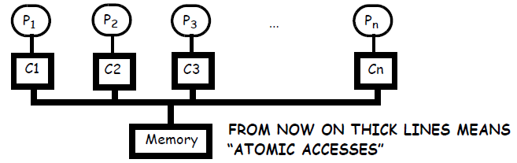
MEMORY ACCESS ATOMICITY
A long time ago, processors were not pipelined, were connected by a single, circuit-switched bus, no store buffer
On a coherence transaction, processor blocks, cache gets access to the bus and complete the transaction in remote caches atomically
  COHERENCE TRANSACTION DID NOT OVERLAP IN TIME
  THUS THE PROTOCOL WORKED EXACTLY AS ITS FSM
THE COHERENCE TRANSACTION IS PERFORMED ATOMICALLY WHEN THE BUS IS RELEASED
Today we must deal with non-atomic transactions

Slide 21
MEMORY ACCESS ATOMICITY
Assume processor P1 has no copy of X in its cache
and processor P2 has a Modified (unique) copy of X in its cache in the cycle the load of P1 reaches its cache
Shared memory program cannot detect the difference between the load returning x1 or the load returning x3, since x3 would be returned if loads were executed instantaneously but P2 was 4 times faster.

Slide 22
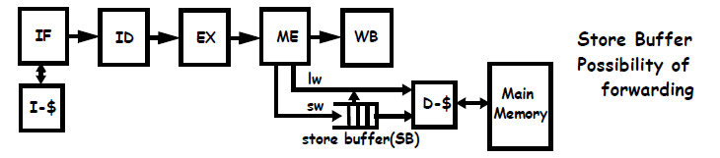
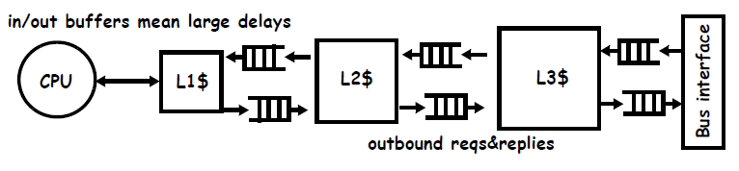
TODAY COHERENCE TRANSACTIONS ARE NON-ATOMIC

Slide 23
MEMORY ACCESS ATOMICITY--SUFFICIENT CONDITION
COHERENCE TRANSACTIONS CANNOT HAPPEN INSTANTANEOUSLY
  MUST MAKE THEM LOOK ATOMIC TO THE SOFTWARE
  WELL-KNOWN PROBLEM: DATABASE SYSTEMS, CRITICAL SECTION
CONDITION:MAKE SURE THAT ONLY ONE VALUE IS ACCESSIBLE AT ANY ONE TIME
DEFINITIONS
  A load is performed at the point in time when its value is bound (atomic) and cannot be recalled
  A store is performed with respect to thread i at the point in time when a load of thread i cannot return a value prior to the store
  A store is globally performed when it is performed with respect to all threads
  A load is globally performed when it is performed and the store providing the value is also globally performed
Enforce the following SUFFICIENT conditions (not necessary)
  A global order of stores to the same address exists
  A load must be globally performed before its value can be used
    value is bound
    store is globally performed
This second condition means that no thread can observe a new value while any other thread can still observe the old value

Slide 24
STORE ATOMICITY IN cc-NUMAs
WRITE MISS IN THREAD 0 IN A cc-NUMA WITH MSI INVALIDATE

Slide 25
STORE ATOMICITY AND COHERENCE
The directory locks entry from t1 to t3
  Should home send the block copy to T0 at t1?
  Should home send it at t3 instead?
For store atomicity, T0 cannot return values from its own stores until t4 (nor give them away)
  New copy becomes available atomically at t3
  Store is globally performed at t3
For PLAIN coherence, the block can be released to T0 at t2 (as demonstrated below)
        EXERCISE: Consider now MSI Update
Threads must all observe the same value
While a new value is propagated, no thread can read the new value (including the writing thread) if other threads can still read the old value
Invalidate protocols facilitate store atomicity
  The protocol prevents any other thread from reading the new value until t3, before the requester is allowed to read it (at t4)
MSI update (in which invalidates are replaced by updates) needs a second wave of acks
  Home must give authorization after receiving all acks
THE CONDITIONS ON STORE ATOMICITY ARE SUFFICIENT, NOT NECESSARY

Slide 26
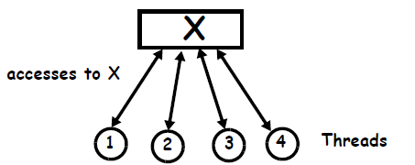
PLAIN COHERENCE
A WEAKER FORM OF COHERENCE
ESTABLISH AN ORDER OF ALL ACCESSES TO THE SAME ADDRESS
THEN APPLY THE FUNDAMENTAL DEFINITION OF COHERENCE
  HERE “LATEST” IS NOT LATEST IN THE TEMPORAL SENSE
  IT IS “LATEST” IN THE ORDER OF ALL ACCESSES
FORMAL MODEL:
RULES OF THE MODEL:
  SINGLE COPY OF EACH DATA
  ACCESSES ONE BY ONE IN THREAD ORDER TO EACH ADDRESS
A system is coherent if its memory accesses to each address can be executed correctly in thread order in a system with one single copy of each memory address

Slide 27

COHERENCE: DEFINITION
“A system is coherent iff, for every execution and for any memory location, it is possible to construct a total order of all memory operations to the location such that:
  memory operations of each thread to the location occur in thread order
  the value returned by a load is the value of the latest Store to the location in the serial order”
NOTE: 1) ACCESSES BY EACH THREAD MUST APPEAR IN THREAD ORDER
2) NOT NECESSARILY THE TEMPORAL ORDER
Since all accesses to every location are in thread order and every load returns the value of the latest store in the order, I can schedule accesses to one address one by one on the formal model and get the same values returned by all loads

Slide 28
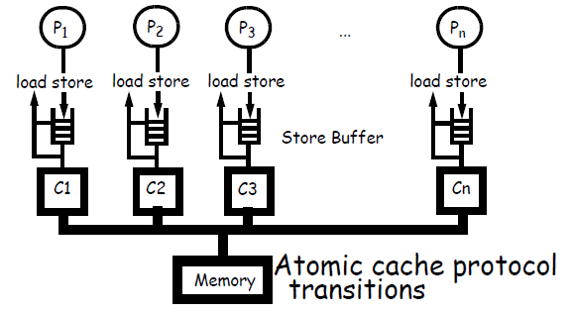
FORWARDING STORE BUFFER
An enlightening example of hardware which is PLAIN coherent but NOT store atomic is that of a store buffer that can forward to loads
STORES ARE INSERTED IN THE STORE BUFFER AND ISSUED TO CACHE LATER
LOADS ARE SATISFIED BY STORE BUFFER (IF SAME ADDRESS), OTHERWISE GO TO MEMORY
IMPORTANT: STORE BUFFERS ARE NOT PART OF CACHE COHERENCE

Slide 29
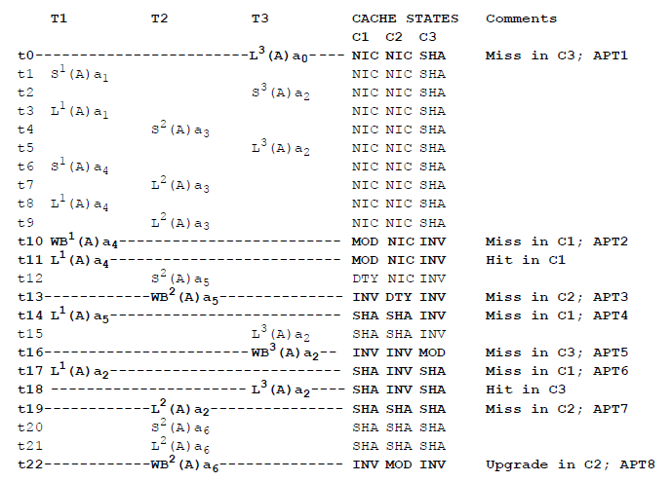
FORWARDING STORE BUFFERS

Slide 30
FORWARDING STORE BUFFERS
Aggressive Store Buffer management
  Stores overwrite previous values to same address (one single value in SB per address)
  Stores forwards values to loads
We first show the order of accesses to caches
INIT ->L³(A)a₀->WB¹(A)a₄->L¹(A)a₄->WB²(A)a₅->L¹(A)a₅-> WB³(A)a₂->L¹(A)a₂-> L³(A)a₂->L²(A)a₂->WB²(A)a₆
We then expand all WBs by local lw/sw’s
L³(A)a₀ S¹(A)a₁ L¹(A)a₁ S¹(A)a₄ L¹(A)a₄ L¹(A)a₄ S²(A)a₃ L²(A)a₃ L²(A)a₃ S²(A)a₅ L¹(A)a₅ S³(A)a₂ L³(A)a₂ L³(A)a₂ L¹(A)a₂ L³(A)a₂ L²(A)a₂ S²(A)a₆ L²(A)a₆
Temporal order: a₀-> a₁-> a₂-> a₃-> a₄-> a₅-> a₆
Coherence order: a₀-> a₁-> a₄-> a₃-> a₅-> a₂-> a₆
P1 observes a₁-> a₄-> a₅-> a₂
P2 observes a₃-> a₅-> a₂-> a₆
P3 observes a₀-> a₂

Slide 31
GENERALIZATIONS
“PRIVACY PRINCIPLE”: A THREAD MAY ACCESS ITS OWN PRIVATE VALUES WHICH ARE NOT PROPAGATED TO OTHER THREADS WITHOUT VIOLATING COHERENCE
  REASON IS NO OTHER THREAD CAN OBSERVE THE VALUES, SO IT’S EASY TO INSERT THE ACCESSES TO THEM IN A GLOBAL ORDER
THIS RESULT CAN BE GENERALIZED AS FOLLOWS
  Other store buffer managements as recombining is the most aggressive one.
  In lock-up free caches a block can be allocated on a store miss, filled by a store while the miss is pending and the stored value can be read by the thread
  Threads in multithreaded cores can read each other’s values in L1, while a miss is pending
  Cluster of processors running many threads may share pending values in shared buffers (in hierarchical cache systems) or in shared L2 lockup free caches
  A thread may modify and use the values returned by a directory protocol even before invalidations are executed (early ack).

Slide 32
IS THERE ANY NON-COHERENT EXECUTION?YES!
A THREAD OBSERVES TWO STORES OF ANOTHER THREAD OUT OF ORDER
THREADS OBSERVE EACH OTHER’S STORES INSTEAD OF OWN
TWO STORES IN DIFFERENT THREADS ARE NOT ORDERED BUT ARE OBSERVED IN DIFFERENT ORDER BY TWO SEPARATE THREADS
IN THESE THREE CASES, STORES CANNOT BE ORDERED SO THAT THE EXECUTION IS COHERENT
STORES TO THE SAME VARIABLE CANNOT BE EXECUTED AND/OR OBSERVED IN DIFFERENT ORDERS

Slide 33
THE IMPORTANCE OF PLAIN COHERENCE
COHERENCE SEEMS TO BE A VERY WEAK PROPERTY.
HOWEVER, COHERENCE IS EXTREMELY USEFUL FOR THE FOLLOWING REASONS:
  THERE MUST BE A TOTAL ORDER OF STORES TO THE SAME LOCATION SO THAT TWO THREADS CANNOT OBSERVE THE STORES IN DIFFERENT ORDERS (STORES TO THE SAME LOCATION ARE ORDERED)
  IT FACILITATES THE IMPLEMENTATION OF MEMORY CONSISTENCY MODELS, BY PROPAGATING VALUES TIMELY AND EFFICIENTLY.
  IT MAKES SURE THAT, IF A COMPUTATION STOPS SUDDENLY (E.G., A CONTEXT SWITCH) THE MEMORY SYSTEM CONVERGES TO A CONSISTENT STATE FOR ALL DATA, AFTER ALL INSTRUCTIONS IN PROGRESS FINISH AND THE NETWORK AND ALL BUFFERS ARE DRAINED.
  IT TAKES CARE OF THREAD MIGRATION

Slide 34
THE PROBLEM WITH PLAIN COHERENCE
COHERENCE IS NOT COMPOSABLE WITH OTHER POSSIBLE ORDERS
  LOAD-LOAD OR LOAD-STORE ON DIFFERENT LOCATIONS
  INTRA-THREAD DEPENDENCIES
  SYNCHRONIZATION (LOCK, BARRIER)
EXAMPLE
IF THE LOADS IN BOTH THREADS MUST BE ORDERED, THEN IT IS NOT POSSIBLE TO FIND A GLOBAL ORDER OF ALL ACCESSES WHILE MAINTAINING COHERENCE
WHEN A GLOBAL ORDER DOES NOT EXISTS RESONING ABOUT EXECUTIONS IS MUCH MORE COMPLEX
THIS IS BECAUSE THE COHERENCE ORDER IS NOT NECESSARILY THE SAME AS THE TEMPORAL ORDER
NOT THE CASE WITH STORE ATOMICITY

Slide 35
COHERENCE IS NOT SUFFICIENT
Point-to-point Synchronization
  ASSUME A AND flag ARE BOTH 0 INITIALLY
P1 P2
... ...
A:=1; while(flag==0)do nothing;
flag:=1; print A;
... ...
Communication
  ASSUME A AND B ARE BOTH 0 INITIALLY
P1 P2
... ...
A:=1; print B;
B:=2; print A;
... ...
Dekker’s Algorithm (critical section)
  ASSUME A AND B ARE BOTH 0 INITIALLY
P1 P2
... ...
S¹(A):A:=1 S²(B):B:=1
L¹(B): while(B==1); L²(A): while(A==1);
<critical section> <critical section>
A:=0 B:=0
PROGRAMMER’S INTUITION HERE IS THAT ACCESSES FROM DIFFERENT PROCESSES ARE “INTERLEAVED” IN PROCESS ORDER
  DIFFERENT FROM COHERENCE, WHICH APPLIES TO A SINGLE LOCATION
          SEQUENTIAL CONSISTENCY

Slide 36
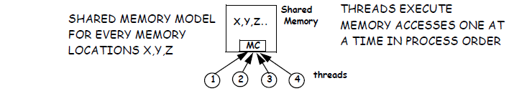
FORMAL MODEL FOR SEQUENTIAL CONSISTENCY
PROGRAM ORDER OF ALL THREADs IS RESPECTED AND ALL MEMORY ACCESSES ARE ATOMIC BECAUSE OF THE MEMORY CONTROLLER
  “A MULTIPROCESSOR IS SEQUENTIALLY CONSISTENT IF THE RESULT OF ANY EXECUTION IS THE SAME AS IF THE MEMORY OPERATIONS OF ALL THE PROCESSORS WERE EXECUTED IN SOME SEQUENTIAL ORDER, AND THE OPERATIONS OF EACH INDIVIDUAL PROCESSOR APPEAR IN THE SEQUENCE IN THE ORDER SPECIFIED BY ITS PROGRAM”
“..ANY EXECUTION, AS IF…. IN SOME SEQUENTIAL ORDER”. LET’S LOOK AT “AS IF”
A AND B ARE 0 INITIALLY
P1 P2
A:=1; PRINT B;
B:=2; PRINT A;
  POSSIBLE PRINTED OUTCOMES UNDER SC: (A,B) = (0,0), (1,0),(1,2)
  IMPOSSIBLE OUTCOME UNDER SC: (0,2)
  LOOK AT EXECUTION B:=2 => A:=1 => PRINT A => PRINT B
    SAME RESULTS AS A:=1 => B:=2 => PRINT B => PRINT A
    IT IS SC, EVEN IF THE TEMPORAL ORDER VIOLATES PROCESS ORDER
AS FOR COHERENCE, SC ORDER IS NOT NECESSARILY TEMPORAL ORDER

Slide 37

SEQUENTIAL CONSISTENCY
LOOK AT MEMORY ACCESSES ORDERS THAT MUST BE GLOBALLY PERFORMED BY EACH PROCESSOR OR ENFORCED IN THE TOTAL ORDER OF ALL ACCESSES
IN SC ALL ORDERS MUST BE ENFORCED
ASSUME MEMORY IS ATOMIC: ONLY GP LOADs CAN RETURN VALUES
WHAT DOES THIS MEAN FOR IO PROCESSORS?
LOADs ARE BLOCKING, SO LOAD-LOAD AND LOAD-STORE ORDERS ARE ENFORCED
STOREs ARE NON-BLOCKING (THEY MOVE TO SB)
  STORE-LOAD: LOADs MUST BLOCK IN ME UNTIL SB IS EMPTY
  STORE-STORE: STOREs MUST BE GPed ONE BY ONE FROM SB

Slide 38
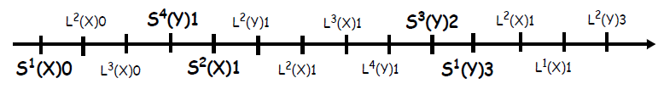
CONDITIONS FOR SC
WE NEED TO FIND A TOTAL COHERENT ORDER OF ALL MEMORY ACCESSES IN WHICH ACCESSES OF EACH THREAD ARE IN THREAD ORDER FOR EVERY EXECUTION (LIKE COHERENCE EXCEPT THAT NOW IT’S FOR ALL MEMORY LOCATIONS, NOT JUST ONE)
  SIMPLY SCHEDULE EACH ACCESS ONE AT A TIME ON THE FORMAL MODEL
SUFFICIENT CONDITION
  EVERY PROCESSOR GLOBALLY PERFORMS ITS MEMORY ACCESSES IN THREAD ORDER
IN THE SC ORDER:
  ACCESSES TO ALL LOCATIONS FROM EACH THREAD MUST BE IN THREAD ORDER (T.O.)
  SOURCE (STORE) OF VALUE MUST PRECEDE THE LOAD OF THE VALUE
  PLUS IMPLIED RULES (on the same location), TO ENFORCE COHERENCE:
    THERE CAN BE NO STORE BETWEEN THE STORE SOURCING THE VALUE AND THE LOAD READING THE VALUE.

Slide 39
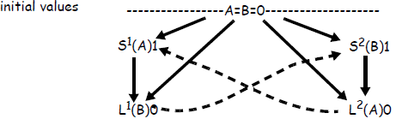
SEQUENTIAL CONSISTENCY
PROBLEM WITH STORE BUFFER: WITH STORE BUFFERS, LOADS CAN BE GPed BEFORE PREVIOUS STORES
  IN SC, A LOAD MUST BE STALLED IF PRIOR STORES ARE NOT GPed
  EFFECTIVE FOR LONG BURSTS OF STORES
    BUT STORES MUST BE PROPAGATED ONE BY ONE BEFORE THE NEXT LOAD ANYWAY
LOOK AT DEKKER AGAIN
A and B are both 0 and cached as Shared initially
T1 T2
S¹(A)1 S²(B)1
L¹(B)0 L²(A)0
  THIS IS NOT AN SC EXECUTION
  EXECUTION GRAPH HAS CYCLES ➔ EXECUTION CANNOT BE ORDERED
    With store buffers the outcome can be (0,0)
    T1 executes A:=1, which stays in the SB
    T2 executes B:=1, which stays in the SB
    Under MSI invalidate T1 and T2 both read 0

Slide 40
CONCLUSION ON SC
PROBLEM WITH STORE BUFFERS
  SC CANNOT REALLY TAKE ADVANTAGE OF STORE BUFFERS
PROBLEM WITH COMPILERS
  TAKE AGAIN PT-TO-PT SYNCHRONIZATION
    P1 P2
    ... ...
    A:=1; while(flag==0)do nothing;
    flag:=1; print A;
    ... ...
  SINCE THERE IS NO DEPENDENCY BETWEEN flag AND A, THE COMPILER MAY REORDER THE TWO INSTRUCTIONS IN P1
  MIGHT ALSO REMOVE THE LOOP ON flag IN P2
  NEXT IDEA: CHANGE THE RULES
  MEMORY CONSISTENCY MODELS

Slide 41
MEMORY CONSISTENCY MODELS
ARE THERE OTHER PROGRAMMER’S INTUITIONS?
  SUCH AS THOSE PROVIDED BY SYNCHRONIZATION?
  FOR EXAMPLE, DEKKER’S ALGORITHM IS NOT USED IN PRACTICE
    gets complex for more than 2 processors and to solve the deadlock
  WHENEVER SHARED VARIABLES ARE READ/WRITE THEY SHOULD BE PROTECTED BY LOCKS
    BAR IS 0 INITIALLY
  P1 P2
  A:=1; BARRIER(BAR,2);
  B:=2; R1:=A;
  BARRIER(BAR,2); R2:=B;
  Because of the barrier, the result is always SC and P2 returns (1,2)
NEXT: WHY SHOULD WE BOTHER ABOUT THE PROGRAMMER ANYWAY?
  WHY COULDN’T WE DESIGN MEMORY ACCESS RULES THAT ARE HARDWARE FRIENDLY AND THEN CONSTRAIN THE PROGRAMMER??
IN ANY CASE WE NEED A MEMORY ACCESS ORDERING MODEL ON WHICH PROGRAMMERS AND MACHINE ARCHITECTS CAN AGREE
  CALLED THE MEMORY CONSISTENCY MODEL
THIS MODEL MUST BE PART OF THE ISA DEFINITION, SINCE IT IS AT THE INTERFACE BETWEEN SOFTWARE AND HARDWARE
  TODAY’S INSTRUCTION SET MANUALS INCLUDE THE MEMORY CONSISTENCY MODEL AS PART OF THE ISA DEFINITION

Slide 42
RELAXED MEMORY CONSISTENCY MODELS
WE CAN RELAX SOME OF THE ACCESS ORDERS OF EACH THREAD
THE MAJOR RELAXATION IS THE STORE-TO-LOAD ORDER: LOADS CAN BYPASS PRIOR STORES
  STORES FROM THE SAME PROCESSOR MUST BE OBSERVED BY ALL OTHER PROCESSORS IN THREAD ORDER (BECAUSE OF STORE-STORE AND LOAD-LOAD ORDERS)
WHAT DOES THIS MEAN FOR IO PROCESSORS?
  ASSUME MEMORY IS ATOMIC: LOADS RETURN VALUES FROM MEMORY ONLY WHEN THE VALUES ARE GPed
  LOAD-LOAD, LOAD-STORE, STORE-STORE: SAME AS FOR SC
  STORE-LOAD: LOADs DON’T WAIT FOR SB EMPTY;

Slide 43
RELAXING STORE-TO-LOAD ORDERS
EXAMPLE: SUN MICRO TOTAL STORE ORDER (TSO)
  DEKKER’S ALGORITHM DOES NOT WORK
  POINT-TO-POINT COMMUNICATION STILL WORKS
COMBINING OF STORES IN THE STORE BUFFER CAN ONLY BE DONE IF THE STORES ARE NOT SEPARATED BY STORES TO OTHER ADDRESSES
ACCESSES TO CACHE ARE SUBMITTED OUT OF PROGRAM ORDER
VALUES MAY OR MAY NOT BE FORWARDED FROM SB TO LOADS
  NO FORWARDING FROM SB ➔ STORE ATOMIC
  FORWARDING FROM SB ➔ PLAIN COHERENT (CASE OF TSO)
    THIS MEANS THAT SOME LOADS IN TSO RETURN VALUES EVEN IF THEY ARE NOT GPed

Slide 44
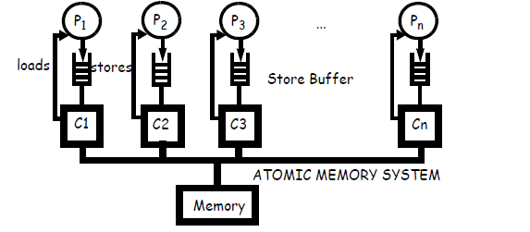
NO FORWARDING FROM SB
IMPORTANT NOTE: THE STORE BUFFER IN THE MODEL DOES NOT HAVE TO BE A PHYSICAL STORE BUFFER. THE SB IN THE MODEL REPRESENTS THE PRIVATE STORE PIPELINE OF THE CORE OR THREAD.(EXAMPLE: LOCKUP-FREE CACHE)
ATOMIC STORES. LOADS ONLY RETURN GPed VALUES
VALID EXECUTION (NOT VALID IN SC)
INIT: A=B=0
T1 T2
S¹(A)1 S²(B)1
L¹(B)0 L²(A)0
THEREFORE DEKKER’S ALGORITHM DOES NOT WORK

Slide 45
NO FORWARDING FROM SB
VALID EXECUTION
INIT: A=B=0
T1 T2
S¹(A)1 S²(B)1
L¹(B)0 L²(A)0
  NO ARROW BETWEEN STORE AND LOAD IN EACH THREAD
  NO GLOBAL ORDER BETWEEN THE STORE AND LOAD IN EACH THREAD
  STILL STORE ATOMIC OVERALL ➔ GLOBAL ORDER IS COHERENT

Slide 46
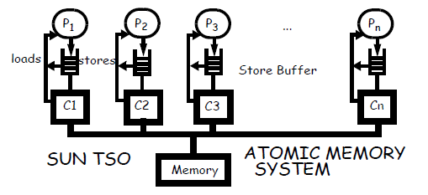
FORWARDING FROM SB (TSO)
NOTE AGAIN THAT THIS MODEL IS AN ABSTRACT VIEW OF THE MEMORY BEHAVIOR
  THE STORE BUFFER IN THE MODEL IS THE “STORE PIPELINE” OF MEMORY ACCESSES BY EACH PROCESSOR
  AS LONG AS A STORE CAN ONLY BE OBSERVED BY ITS OWN THREAD IT DOES NOT NEED TO PROPAGATE TO OTHERS
  AS SOON AS IT CAN BE OBSERVED BY OTHER THREADS, IT MUST BECOME VISIBLE TO ALL, ATOMICALLY
  FOR EXAMPLE, IF L1 IS PRIVATE TO A THREAD AND IS LOCKUP FREE, THEN THE THREAD CAN RETURN VALUES FROM L1 THAT ARE NOT GPed
  BUT IF L1 IS SHARED BY SEVERAL THREADS, L1 MAY NOT RETURN A NON-GP VALUE.

Slide 47
FORWARDING FROM SB (TSO)
CODE CORRECT UNDER FORWARDING BUT NOT WITHOUT FORWARDING
INIT: A=B=C=0
T1 T2
S¹(A)1 S²(B)1
S¹(C)1 S²(C)2
L¹(C)1 L²(C)2
L¹(B)0 L²(A)0
IN THIS CODE IS THERE STILL A POSSIBLE COHERENT ORDER OF ALL ACCESSES? ANSWER: NO
THE EXECUTION IS NOT STORE ATOMIC, BUT IT IS STILL PLAIN COHERENT (CONSIDER EACH ADDRESS SEPARATELY)
WITH FORWARDING (OR UNDER SC) THERE WOULD BE AN ARROW BETWEEN STORE AND LOAD IN EACH THREAD AND THIS EXECUTION WOULD NOT BE POSSIBLE

Slide 48
SUN MICRO RELAXED MEMORY ORDER (RMO)
IN RMO ONLY INTRA-THREAD MEMORY DEPENDENCY ORDER IS ENFORCED
  AS IN ALL UNIPROCESSORS
NO IMPLICIT ORDER BETWEEN THREADS
MEMBAR INSTRUCTIONS SPECIFY ORDERS BETWEEN THREADS EXPLICITELY
  4 BITS ARE USED TO SPECIFY UP TO 4 ORDERS
  LAOD-LOAD ➔ FENCE FORCING ALL PRECEDING LOADS TO BE GPed BEFORE ANY LOAD MAY BE ISSUED
  LOAD-STORE ➔FORCES ALL PRECEDING LOADS TO BE GP BEFORE ANY STORE
  STORE-STORE ➔ FORCES ALL PRECEDING STORES TO BE GP BEFORE ANY STORE
  STORE-LOAD ➔ FORCES ALL PRECEDING STORES TO BE GP BEFORE ANY LOAD
MEMBARS ARE INSERTED BY THE COMPILER OR PROGRAMMER
  MEMBARs ARE EXTRA INSTRUCTIONS
T1 T2 T3
A:=1; while(A==0); R2:=B;
B:=1; R3:=A;
  NOT SEQUENTIALLY CONSISTENT (YIELDS NON-SC OUTCOMES)
T1 T2 T3
A:=1; while(A==0); R2:=B;
MEMBAR 0100 MEMBAR 100
B:=1; R3:=A;
  WITH MEMBARS: SEQUENTIALLY CONSISTENT (YIELDS SC OUTCOMES ONLY)

Slide 49
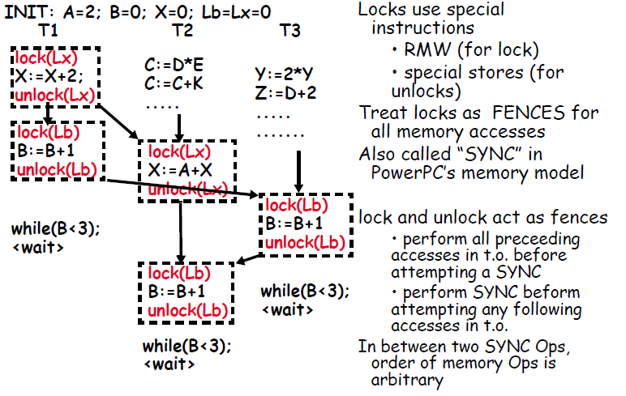
MCM USING SYNCHRONIZATION

Slide 50
WEAK ORDERING
MULTITHREADED EXECUTION USES LOCKING MECHANISMS TO AVOID RACE CONDITIONS.
EXECUTIONS INCLUDE VARIOUS PHASES:
  ACCESSES TO PRIVATE OR READ-ONLY SHARED DATA, OR
  ACCESSES TO SHARED MODIFIABLE DATA, PROTECTED BY LOCKS AND BARRIERS.
IN EACH PHASE THE THREAD HAS EXCLUSIVE ACCESS TO ALL ITS DATA, MEANING
  NO OTHER THREAD CAN WRITE TO THEM, OR
  NO OTHER THREAD CAN READ THE DATA IT MODIFIES
ACCESSES TO SYNCHRONIZATION DATA (INCLUDING ALL LOCKS AND SHARED DATA IN SYNCHRONIZATION PROTOCOLS) ARE TREATED DIFFERENTLY BY THE HARDWARE FROM ACCESSES TO OTHER SHARED AND PRIVATE DATA.
  THEY ACT AS FENCES ON ALL ACCESSES
  MUST GLOBALLY PERFORM ALL ACCESS PRECEDING SYNC ACCESS IN T.O.
  MUST GLOBALLY PERFORM SYNC ACCESS BEFORE ALL FOLLOWING ACCESSES IN T.O.

Slide 51
WEAK ORDERING
ACCESSES TO OTHER (NON-SYNC) SHARED AND PRIVATE DATA MUST ENFORCE UNIPROCESSOR DEPENDENCIES ON SAME ADDRESS
  OTHERWISE, NO REQUIREMENT
  EVEN COHERENCE IS NOT A REQUIREMENT
VARIABLES THAT ARE USED FOR SYNCHRONIZATION MUST BE DECLARED AS SUCH (e.g., flag, A and B below) OR SPECIFIC STATEMENTS MUST BE LABELLED OR MARKED
  SO THAT EXECUTION ON THESE VARIABLES ARE SAFE.
    A=flag=0 initially
T1 T2
A:=1; while(flag==0)do nothing;
flag:=1; print A;
... ...
Flag MUST BE DECLARED AS SYNC VARIABLE
A=B=0 initially
T1 T2
A:=1 B:=1
while(B==1); while(A==1);
<critical section> <critical section>
A:=0 B:=0
A AND B MUST BE DECLARED AS SYNC VARIABLES

Slide 52
WEAK ORDERING
A RMW ACCESS TO A MEMORY LOCATION IS GLOBALLY PERFORMED ONCE BOTH THE LOAD AND STORE IN THE RMW ACCESS ARE GLOBALLY PERFORMED.
  ATOMICITY MUST ALSO BE ENFORCED BETWEEN THE TWO ACCESSES (EASIER IN WRITE-INVALIDATE PROTOCOLS--TREAT THE T&S AS A STORE IN THE PROTOCOL)
SYNC OPERATION MUST BE RECOGNIZABLE BY THE HARDWARE AT THE ISA LEVEL
  RMW (T&S)
  SPECIAL LOADS AND STORES FOR SYNC VARIABLE ACCESSES
ORDERS TO ENFORCE:
Op = regular load or store
Sync = any synchronization access, e.g., swap, T&S, special load/store

Slide 53
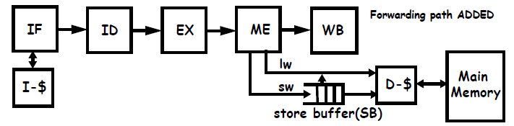
WEAK ORDERING
WHAT DOES IT MEAN FOR IO PROCESSORS?
  NOTE: HERE LOADS CAN RETURN VALUES EVEN IF THEY ARE NOT GPed
REGULAR STORES IN THE STORE BUFFER CAN BE EXECUTED IN ANY ORDER, IN PARALLEL
REGULAR LOADS NEVER WAIT FOR STORES AND CAN BE FORWARDED TO
WHEN A SYNC ACCESS IS EXECUTED, IT IS TREATED DIFFERENTLY:
  IT BLOCKS IN THE MEMORY STAGE UNTIL ALL STORES IN THE STORE BUFFER ARE GLOBALLY PERFORMED WHICH ENFORCES OP-TO-SYNC.
  SYNC-TO-OP AND SYNC-TO-SYNC ORDERS ARE AUTOMATICALLY ENFORCED BY IO PROCESSOR

Slide 54
RELEASE CONSISTENCY
A REFINEMENT OF WEAK ORDERING
  DISTINGUISHES BETWEEN ACQUIRES AND RELEASES OF LOCK
  ACQUIRES MUST BE BE GLOBALLY PERFORMED BEFORE STARTING ANY FOLLOWING MEMORY OPS
  ALL MEMORY OPS MUST BE GLOBALLY PERFORMED BEFORE A RELEASE CAN START
  MORE “RELAXED” THAN WEAK ORDERING
PROGRAMMERS MUST MARK SYNCHRONIZATIONS AS “ACQUIRES” OR “RELEASES”
  ACQUIRES AND RELEASES MUST BE SEQUENTIALLY CONSISTENT
ORDERS TO ENFORCE GLOBALLY
  Op = regular load or store
  Sync = Acquire or Release

Slide 55
RELEASE CONSISTENCY
CONSIDER THE CODE OF T2 IN THE WO EXAMPLE
A LOT MORE CONCURRENCY IN RELEASE vs WEAK
  THE CODE BEFORE UNLOCK(Lx) CAN BE EXECUTED IN PARALLEL
  THE CODE AFTER LOCK(Lb) CAN ALL BE EXECUTED IN PARALLEL
THE PROBLEM IS TO BE ABLE TO TAKE ADVANTAGE OF THIS ADDITIONAL CONCURRENCY WITHIN EACH THREAD

Slide 56
RELEASE CONSISTENCY
WHAT DOES IT MEAN FOR IO PROCESSOR?
NO ORDERING RULES AMONG REGULAR LOADs/STOREs
  REGULAR STORES IN THE STORE BUFFER CAN BE EXECUTED IN ANY ORDER, IN PARALLEL
  REGULAR LOADS NEVER WAIT FOR REGULAR STORES IN SB AND CAN BE FORWARDED TO
  LOADS RETURN VALUE EVEN IF THE VALUE IS NOT GP.
ACQUIRES ARE BLOCKING: THUS ACQUIRE-OP AND ACQUIRE-SYNC ORDER IS AUTOMATICALLY ENFORCED
A RELEASE IS INSERTED IN THE STORE BUFFER WITH REGULAR STORES.
  OP-RELEASE AND RELEASE-RELEASE ORDERS: RELEASES MUST WAIT IN SB UNTIL ALL PRIOR STORES AND RELEASES ARE GP (LOADS PRIOR TO THE RELEASE HAVE RETIRED)
  RELEASE-ACQUIRE ORDER: AN ACQUIRE WAITS UNTIL ALL PRIOR RELEASES IN SB HAVE BEEN GPed

Slide 57
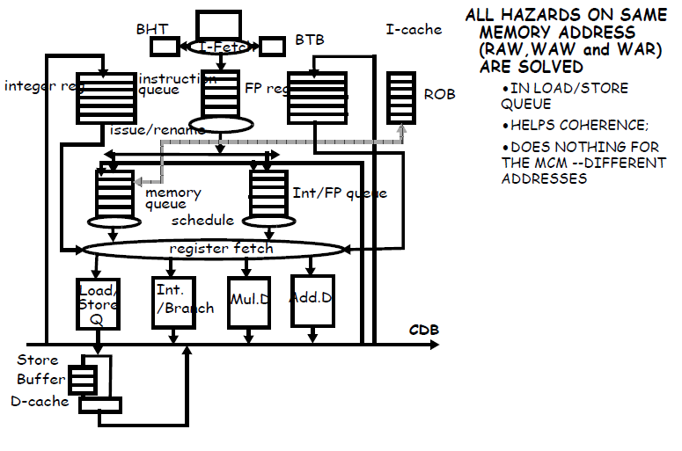
OoO PROCESSORS

Slide 58
LOADs/STOREs HANDLING IN SPECULATIVE OoO PROCESSORS
WHEN THE LOAD ADDRESS IS KNOWN, THE LOAD CAN ISSUE TO CACHE
  PROVIDED NO STORE WITH THE SAME OR AN UNKNOWN ADDRESS IS AHEAD IN THE L/S QUEUE (CONSERVATIVE MEMORY DISAMBIGUATION)
  CAN EVEN BE ISSUED BEFORE ADDRESSES OF PREVIOUS STORES ARE KNOWN (SPECULATIVE MEMORY DISAMBIGUATION)
THE VALUE OF A LOAD ISSUED TO CACHE IS RETURNED AND USED SPECULATIVELY BEFORE THE LOAD RETIRES
  THE LOAD VALUE IS NOT BOUND UNTIL THE LOAD RETIRES (IT IS NOT PERFORMED, JUST SPECULATIVELY PERFORMED)
  THE VALUE CAN BE RECALLED FOR ALL KINDS OF REASONS (MISSPREDICTED BRANCH, EXCEPTION, ETC...)
STORES CANNOT UPDATE CACHE UNTIL THEY REACH THE TOP OF THE ROB
  AS STORES REACH THE TOP OF THE REORDER BUFFER AND OF THE L/S QUEUE THEY COMMIT BY MOVING TO THE STORE BUFFER

Slide 59
CONSERVATIVE MCM ENFORCEMENT
THE ONLY TIME THAT IT IS KNOWN FOR SURE THAT A MEMORY ACCESS IS PERFORMED IS WHEN IT REACHES THE TOP OF ROB
  BEFORE THAT IT IS SPECULATIVE
COULD WAIT TO EXECUTE AND PERFORM A LOAD IN CACHE UNTIL IT REACHES THE TOP OF ROB
  DOWNSIDE: NO MEMORY LATENCY TOLERANCE DUE TO OoO EXECUTION
IN THIS CONSERVATIVE SCHEME, LOADs AND STOREs CAN STILL BE PREFETCHED IN CACHE (NON-BINDING PREFETCHES)
  IF THE LOAD OR STORE DATA IS IN THE RIGHT STATE IN CACHE AT THE TOP OF THE ROB, PERFORMING THE ACCESS TAKES ONE CACHE CYCLE.
  STILL, LOAD VALUES CAN NOT BE USED SPECULATIVELY
NEXT IDEA: EXPLOIT SPECULATIVE EXECUTION TO SPECULATIVELY VIOLATE MEMORY ORDERS
WORKS BECAUSE ORDER VIOLATIONS ARE RARE

Slide 60
SPECULATIVE VIOLATIONS OF SEQUENTIAL CONSISTENCY
LET’S LOOK AGAIN AT ORDERS TO ENFORCE GLOBALLY
BECAUSE STOREs ARE SENT TO THE STORE BUFFER ONLY WHEN THEY RETIRE, THE LOAD-STORE AND STORE-STORE ORDERS ARE AUTOMATICALLY SATISFIED IN THE PROCESSOR
  PROVIDED STOREs ARE GLOBALLY PERFORMED IN ORDER FROM THE STORE BUFFER
REMAINING ORDERS ARE LOAD-LOAD AND STORE-LOAD
  THE SECOND ACCESS IN THESE ORDERS IS A LOAD
EXPLOIT SPECULATION

Slide 61
SPECULATIVE VIOLATIONS OF SEQUENTIAL CONSISTENCY
ASSUME THAT A MEMORY ACCESS (LOAD OR STORE) TO X PRECEDES A LOAD OF Y AND THAT THE ORDER MUST BE ENFORCED BY THE MODEL, I.E.,
    LOAD X/STORE X, followed by
    LOAD Y
  PERFORM LOAD Y SPECULATIVELY BEFORE THE ACCESS TO X
  USE THE VALUE RETURNED BY LOAD Y SPECULATIVELY.
  LATER, WHEN ACCESS TO X RETIRES AT THE TOP OF ROB, CHECK TO SEE WHETHER THE VALUE OF Y HAS CHANGED AND ROLL BACK IF IT HAS
  OR (MORE SIMPLY) CHECK THE VALUE OF Y WHEN LOAD Y REACHES THE TOP OF ROB
TWO MECHANISMS ARE NEEDED: VALIDATION AND ROLLBACK
VALIDATION OF LOAD VALUES AT THE TOP OF ROB
  CHECK THE VALUE OF Y BY RE-PERFORMING THE LOAD IN CACHE (USES EXTRA CACHE BANDWIDTH AND POSSIBLY CYCLES)
  OR: MONITOR EVENTS THAT COULD CHANGE THE VALUE OF Y BETWEEN THE TIME LOAD Y PERFORMS SPECULATIVELY UNTIL LOAD Y COMMITS
    “”EVENTS” INCLUDE INVALIDATES, UPDATES OR CACHE REPLACEMENTS IN THE NODE’S CACHE
    SNOOP THE LOAD Q
“LOAD VALUE RECALL”: ROB ROLLBACK, AS FOR MISPREDICTED BRANCHES

Slide 62
SPECULATIVE VIOLATIONS OF SEQUENTIAL CONSISTENCY
LOAD-LOAD ORDER: USE LOAD VALUE RECALL
STORE-LOAD ORDER: USE LOAD VALUE RECALL + STALL LOADS AT TOP OF ROB UNTIL ALL PREVIOUS STOREs HAVE BEEN GLOBALLY PERFORMED
LOAD-STORE ORDER: STOREs RETIRE AT TOP OF ROB, BY THAT TIME ALL PREVIOUS LOADS HAVE RETIRED
STORE-STORE ORDER: STOREs RETIRE AT TOP OF ROB + GLOBALLY PERFORM STOREs FROM STORE BUFFER ONE BY ONE IN T.O.
PERFORMANCE ISSUES
  A LOAD MAY REACH THE TOP OF THE ROB BUT CANNOT PERFORM AND IS STALLED BECAUSE OF PRIOR STORES IN THE STORE BUFFER
  THIS BACKS UP THE ROB (AND OTHER INTERNAL BUFFERS) AND EVENTUALLY STALLS THE PROCESSOR
NEXT IDEA: RELAX STORE-LOAD ORDER

Slide 63
SPECULATIVE TSO VIOLATIONS
LOAD-LOAD ORDER: USE LOAD VALUE RECALL
STORE-LOAD ORDER: NO NEED TO ENFORCE. THUS VALUE OF LOAD SHOULD NOT BE RECALLED IF ALL PRECEDING PENDING ACCESSES IN THE LOAD/STORE Q ARE STOREs (POSSIBLE OPTIMIZATION) + LOADS DON’T WAIT ON STORES IN SB
LOAD-STORE ORDER: STOREs RETIRE AT TOP OF ROB
STORE-STORE ORDER: STOREs RETIRE AT TOP OF ROB + STOREs ARE GLOBALLY PERFORMED FROM STORE BUFFER IN T.O.
PERFORMANCE ISSUES:
  IF A LONG LATENCY STORE BACKS UP THE STORE BUFFER THEN STORES CANNOT RETIRE, WHICH MAY BACK UP THE ROB AND OTHER Q’s AND STALL DISPATCH
NEXT IDEA: RELAX FURTHER WITH WEAK ORDERING OR RELEASE CONSISTENCY

Slide 64
SPECULATIVE EXECUTION OF RMW ACCESSES
RMW INSTRUCTIONS ARE MADE OF A LOAD FOLLOWED BY A STORE
  MUST EXECUTE AS A GROUP AND BE ATOMIC
BECAUSE OF THE LOAD, THE VALUE OF THE LOCK IS RETURNED SPECULATIVELY
  BASED ON THE SPECULATIVE LOCK VALUE THE CRITICAL SECTION IS ENTERED OR THE LOCK IS RETRIED SPECULATIVELY
  THIS ACTIVITY IS ALL SPECULATIVE IN THE ROB
  THE STORE IN THE RMW DOES NOT EXECUTE IN CACHE UNTIL IT REACHES THE TOP OF ROB
  LOADs IN RMW ACCESSES MUST REMAIN SUBJECT TO LOAD VALUE RECALL UNTIL THE RMW IS RETIRED
  WILL BE ROLLED BACK IF VIOLATION IS DETECTED
BECAUSE OF THE STORE, THE RMW ACCESS DOES NOT UPDATE MEMORY (AND CANNOT PERFORM) UNTIL THE TOP OF THE ROB
  IF THE STORE CAN EXECUTE AT THE TOP OF THE ROB, THEN NO OTHER THREAD GOT THE LOCK DURING THE TIME THE RMW WAS SPECULATIVE
  THE LOAD AND THE STORE CAN BE PERFORMED ATOMICALLY IN CACHE WITH A WRITE-INVALIDATE PROTOCOL

Slide 65
SPECULATIVE VIOLATIONS OF WEAK ORDERING
OP-TO-SYNC:
  ANY ACCESS TO A SYNC VARIABLE MUST BE GLOBALLY PERFORMED AT THE TOP OF THE ROB, AFTER ALL PREVIOUS ACCESSES HAVE RETIRED AND AFTER ALL STORES IN THE STORE BUFFER HAVE BEEN GLOBALLY PERFORMED
SYNC-TO-OP/SYNC-TO-SYNC:
  NO OP OR SYNC ACCESS FOLLOWING AN ACCESS TO A SYNC VARIABLE CAN PERFORM UNTIL THE SYNC ACCESS HAS BEEN GLOBALLY PERFORMED.
    THIS IS AUTOMATICALLY ENFORCED FOR STORES AND FOR SYNC ACCESSES SINCE THEY CANNOT BE GLOBALLY PERFORMED UNTIL THEY REACH THE TOP OF THE ROB.
    NO SYNC ACCESS MAY COMMIT AND PERFORM UNTIL THE STORE BUFFER IS EMPTY.
    A LOAD OF A SYNC VARIABLE (INCLUDING THE LOAD IN A RMW ACCESS) CAN BE SPECULATIVELY PERFORMED PROVIDED IT IS SUBJECT TO LOAD VALUE RECALL.
REGULAR LOADS ARE NOT SUBJECT TO LOAD VALUE RECALL

Slide 66
SPECULATIVE VIOLATIONS OF RELEASE CONSISTENCY
IN RC, A RELEASE MAY NOT PERFORM UNTIL ALL PREVIOUS ACCESSES ARE GLOBALLY PERFORMED AND ACCESSES FOLLOWING AN ACQUIRE MUST BE DELAYED UNTIL THE ACQUIRE IS GLOBALLY PERFORMED.
RC REQUIRES THAT ACQUIRES MUST BE PERFORMED BEFORE ANY FOLLOWING ACCESS CAN PERFORM.
  HOWEVER ALL LOADS, INCLUDING RMW LOADS, MAY BE SPECULATIVELY PERFORMED.
  REGULAR LOADS ARE NOT SUBJECT TO RECALL,
  ONLY SYNC LOADS IN ACQUIRES ARE SUBJECT TO RECALL
RELEASES ARE PUT IN THE STORE BUFFER AS “SPECIAL” STORES (UNLESS THEY ARE RMW INSTRUCTIONS)
  BY THAT TIME ALL PREVIOUS LOADS HAVE BEEN PERFORMED
  RELEASE MUST WAIT IN SB UNTIL ALL PREVIOUS STORES HAVE BEEN PERFORMED
ALL STORES IN THE STORE BUFFER (BESIDES RELEASES) CAN PERFORM IN ANY ORDER
ACQUIRES MUST WAIT UNTIL ALL PRIOR RELEASES IN SB ARE PERFORMED

